Slide 1

307307 Introduction to Text Mining and Natural Language Processing

Slide 2
What is Natural Language Processing?
Natural Language Processing (NLP) is a field at the intersection of computer science, artificial intelligence, and linguistics focused on enabling computers to understand, interpret, and generate human language.
It forms the foundation for all language technologies we use today, from search engines to voice assistants and modern large language models.
A peek into the history of Language AI – Hands on LLMs, Jay Al Ammar Book

Slide 3
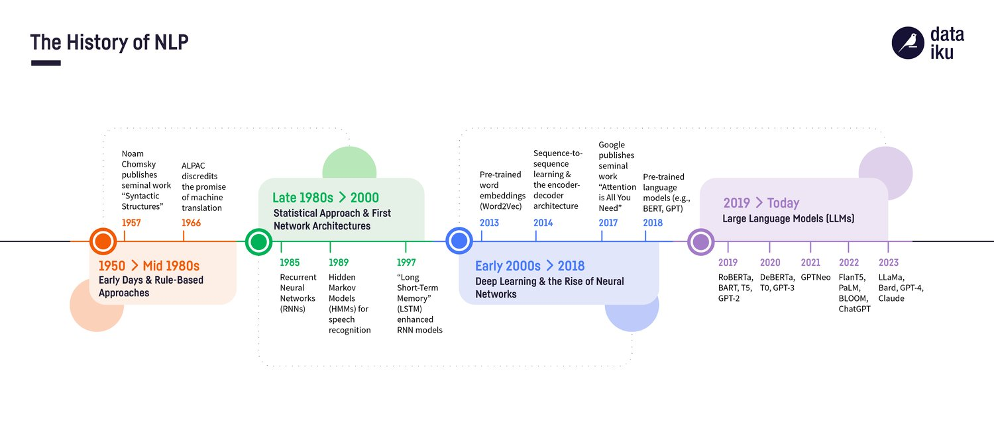
Historical Development of NLP
NLP has evolved dramatically over the decades:
1950s-1960s: Rule-Based Approaches
Focus on machine translation during the Cold War
Primitive rule-based systems with hand-crafted grammars
Limited by the complexity of language rules
1970s-1980s: Statistical Revolution Begins
Introduction of probabilistic models
Hidden Markov Models for part-of-speech tagging
Still limited by computational power and data availability
1990s-2000s: Statistical NLP Flourishes
Large text corpora become available
Machine learning approaches gain prominence
Statistical machine translation emerges
2010-2018: Neural Revolution
Word embeddings (Word2Vec, GloVe) transform representation
Recurrent Neural Networks and LSTMs for sequence modeling
Attention mechanisms improve performance
2018-Present: Transformer Era
BERT, GPT, and other transformer models revolutionize the field
Pre-training and fine-tuning paradigm
Increasingly human-like language understanding capabilities

Slide 4
Why is NLP Challenging?
Human language is ambiguous: Words and sentences can have multiple interpretations
Lexical ambiguity: When a word has multiple meanings
Example: "The bank is closed" (financial institution or riverbank)
Example: "The suit was expensive" (Formal set of clothes or Legal proceeding)
Computational challenge: Systems must select the correct word sense from multiple possibilities
Syntactic ambiguity: When a sentence can be parsed in multiple ways
Example: "I saw the man with the telescope" (Who has the telescope?)
Example: "Flying planes can be dangerous" (The act of flying planes or planes that are flying?)
Computational challenge: Models must determine the correct grammatical structure
Semantic ambiguity: When the meaning of a sentence has multiple interpretations
Example: "The chicken is ready to eat" (Ready to be eaten or ready to consume food?)
Example: "John and Mary got married last year" (To each other or to other people?)
Computational challenge: Systems must infer the intended meaning based on context
Pragmatic ambiguity: When the intended meaning depends on context, intent, or implied information
Example: "It's cold in here" (Statement of fact or request to close a window/turn up heat?)
Example: "Do you know what time it is?" (Yes/no question or request for the time?)
Computational challenge: Models must understand communicative intent beyond literal meaning

Slide 5
Common NLP Applications
1. Sentiment analysis: Determining the emotional tone of text
Identifying if customer reviews are positive, negative, or neutral
Tracking public opinion on products, services, or topics
2. Machine translation: Translating text between languages
Converting text from one language to another while preserving meaning
Handling cultural and linguistic differences across languages
3. Text generation: Creating human-like text
Automatic summarization of longer documents
Creative writing assistance and content creation
Dialogue systems for conversational AI
4. Question answering: Providing answers to natural language questions
Extracting answers from documents or knowledge bases
Understanding user intent and providing relevant information
5. Information extraction: Identifying and extracting structured information from text
Pulling key data points from unstructured documents
Converting text documents into structured databases
6. Text classification: Categorizing text into predefined categories
Sorting emails into spam/not spam
Organizing documents by topic or content type

Slide 6
Fundamental NLP Techniques

Slide 7
NLTK (Natural Language Toolkit)
NLTK (Natural Language Toolkit) is a leading platform for building Python programs that work with human language data. Developed by Steven Bird and Edward Loper at the University of Pennsylvania, NLTK has become one of the most widely used libraries for natural language processing (NLP) in Python since its initial release in 2001.
Key Features of NLTK
Comprehensive Toolkit: NLTK provides easy-to-use interfaces to over 50 corpora and lexical resources, along with a suite of text processing libraries for classification, tokenization, stemming, tagging, parsing, and semantic reasoning.
Educational Purpose: NLTK was designed with education in mind. It comes with comprehensive documentation and a book ("Natural Language Processing with Python") that makes it accessible for beginners.
Built-in Datasets: NLTK includes various pre-loaded corpora like the Brown Corpus, WordNet, and many others that are useful for training and testing NLP algorithms.
Modular Architecture: The library is organized into modules focused on specific NLP tasks, making it easy to use just the components you need.
Core Functionality
NLTK supports many essential NLP tasks:
Tokenization: Breaking text into words, sentences, or other meaningful elements
Part-of-speech tagging: Identifying the grammatical parts of speech for words
Named entity recognition: Identifying names of people, organizations, locations, etc.
Stemming and lemmatization: Reducing words to their base or root form
Parsing: Analyzing syntactic structures of sentences
Semantic analysis: Working with meaning representations
Sentiment analysis: Determining positive, negative, or neutral sentiment in text

Slide 8
Tokenization
Tokenization: Breaking text into words, phrases, or other meaningful elements
Word tokenization: Splitting "I love NLP." into ["I", "love", "NLP", "."]
Subword tokenization: Breaking words into meaningful pieces (e.g., "playing" → ["play", "##ing"])
Character tokenization: Splitting text into individual characters

Slide 9

Tokenize text using NLTK package
from nltk.tokenize import word_tokenize
#punkt is a pretrained tokenization model used for splitting text into sentences and words.
nltk.download('punkt')
sentence = "Large language models are revolutionizing business applications."
tokens = word_tokenize(sentence)
print(tokens)
Output:
['Large', 'language', 'models', 'are', 'revolutionizing', 'business', 'applications', '.']
[nltk_data] Downloading package punkt to /home/me/nltk_data... [nltk_data] Package punkt is already up-to-date!
Click to Open Code

Slide 10
Normalization
Converting text to a standard form to reduce variability:
# Lowercasing
normalized_tokens = [token.lower() for token in tokens]
print(normalized_tokens)
# Removing punctuation
import re
normalized_tokens = [re.sub(r'[^\w\s]', '', token.lower()) for token in tokens]
print(normalized_tokens)
The regular expression r'[^\w\s]' does the following:
r'...': This denotes a raw string in Python. Raw strings treat backslashes \ as literal characters, which is crucial for regular expressions.
[...]: This represents a character set.^: Inside a character set, ^ negates the set. It means "match any character not in this set.
"\w: This matches any word character, which includes alphanumeric characters (letters and digits) and the underscore (_).
\s: This matches any whitespace character, such as spaces, tabs, and newlines.
Therefore, r'[^\w\s]' matches any character that is not a word character or a whitespace character. In simpler terms, it matches any non-alphanumeric, non-underscore, and non-whitespace character. This effectively targets punctuation marks, symbols, and other special characters.
Output:
['large', 'language', 'models', 'are', 'revolutionizing', 'business', 'applications', '.']['large', 'language', 'models', 'are', 'revolutionizing', 'business', 'applications', '']

Slide 11
Stopwords Removal
Eliminating common words that add little meaning:
#nltk.download('stopwords') #stopwords are common words that are often removed from text as they are not useful for analysis.
from nltk.corpus import stopwords
stop_words = set(stopwords.words('english'))
print("These words are removed from the text: ", stop_words)
filtered_tokens = [token for token in normalized_tokens if token and token not in stop_words]
print(filtered_tokens)
Output:
These words are removed from the text: {'during', 'off', 'each', 'own', 'nor', "we've", "you'll", 'ourselves', 'between', 'same', 'such', 'against', 'but', "mustn't", "aren't", "wouldn't",

Slide 12
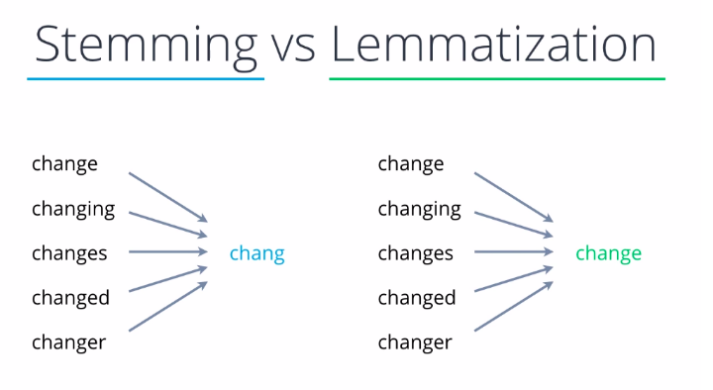
Stemming and Lemmatization
Stemming and lemmatization are text normalization techniques used in Natural Language Processing (NLP) to reduce words to their base or root forms.
They help in improving search engines, text mining, and language modeling by standardizing words with similar meanings.

Slide 13
Stemming
Definition: Stemming is a rule-based process that removes prefixes and suffixes (affixes) from a word to obtain its base form, often producing words that may not be actual words.
Method: Uses algorithms like Porter Stemmer and Snowball Stemmer.
Example:
"Running" → "Run"
"Studies" → "Studi"
"Better" → "Better" (Incorrectly unchanged)
"Caring" → "Car"
Limitations:
Often results in words that are not real words ("Studies" → "Studi").
Does not consider the actual meaning of words.

Slide 14
Lemmatization
Definition: Lemmatization is a dictionary-based approach that reduces words to their meaningful root form (lemma), considering the word's context and part of speech.
Method: Uses linguistic analysis and dictionaries (like WordNet Lemmatizer).
Example:
"Running" → "Run"
"Studies" → "Study"
"Better" → "Good" (Correct Lemma)
"Caring" → "Care"
Advantages:
More accurate than stemming.
Produces real words with proper meanings.
Use Cases:
Stemming is useful when speed is more important than accuracy (e.g., search engines).
Lemmatization is better for semantic analysis where meaning matters (e.g., AI chatbots, NLP applications).

Slide 15
Stemming Example
from nltk.stem import PorterStemmer
stemmer = PorterStemmer()
stemmed_tokens = [stemmer.stem(token) for token in filtered_tokens]
print(stemmed_tokens)
Lemmatizing Example
#nltk.download('wordnet')
from nltk.stem import WordNetLemmatizer
lemmatizer = WordNetLemmatizer()
lemmatized_tokens = [lemmatizer.lemmatize(token) for token in filtered_tokens]
print(lemmatized_tokens)

Slide 16
Representing Text – Converting Text into Numbers
Bag of Words Method.
TF-IDF (Term Frequency-Inverse Document Frequency)

Slide 17
Representing Text - Bag of Words (BoW)
Bag of Words is a fundamental technique in Natural Language Processing (NLP) that represents text as a collection of word frequencies, disregarding grammar and word order.
Core Concept
The Bag of Words model converts text documents into numerical feature vectors by:
Creating a vocabulary of all unique words in the corpus
For each document, counting how many times each vocabulary word appears
Simple Example:
Consider these two short sentences:
"I love natural language processing“
"Processing natural language is fun“
The vocabulary would be:
{"I", "love", "natural", "language", "processing", "is", "fun"}
Document 1 vector: [1, 1, 1, 1, 1, 0, 0]
Document 2 vector: [0, 0, 1, 1, 1, 1, 1]

Slide 18
Representing Text - Bag of Words (BoW)
Applications
BOW is commonly used in:
Text classification (spam detection, sentiment analysis)
Document clustering
Information retrieval
Topic modeling
Advantages
Simple to understand and implement
Computationally efficient
Effective for many basic NLP tasks
Limitations
Loses word order information
Ignores semantics and context
Creates high-dimensional, sparse vectors
Struggles with out-of-vocabulary words

Slide 19
BoW Example
from sklearn.feature_extraction.text import CountVectorizer
corpus = [
"Large language models revolutionize business.",
"Business applications benefit from AI.",
"Language models learn from text data."
]
vectorizer = CountVectorizer()
X = vectorizer.fit_transform(corpus)
print(vectorizer.get_feature_names_out())
print(X.toarray())
['ai' 'applications' 'benefit' 'business' 'data' 'from' 'language' 'large' 'learn' 'models' 'revolutionize' 'text’]
[[0 0 0 1 0 0 1 1 0 1 1 0]
[1 1 1 1 0 1 0 0 0 0 0 0]
[0 0 0 0 1 1 1 0 1 1 0 1]]

Slide 20
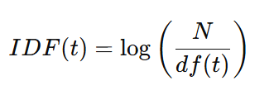
Representing Text - TF-IDF (Term Frequency-Inverse Document Frequency)
Definition:
TF-IDF is a statistical measure that evaluates the importance of a word in a document relative to a collection of documents (corpus).
It improves upon the basic Bag of Words model by weighing terms based on how unique they are to a specific document.
Formula:
TF(t, d): Term Frequency – how often term t appears in document d.
IDF(t): Inverse Document Frequency – how rare term t is across the corpus:
N = total number of documents
df(t) = number of documents containing term t
Key Idea:
TF-IDF increases when a word appears frequently in a document but rarely across the corpus, making it a good indicator of relevance.

Slide 21
Example – Word A vs. Word B
Corpus size: 10 documents
Word A appears in 1 document
Word B appears in 8 documents
In the target document, both words appear once (TF = 1)
Term | df(t) | TF in the Current Document | IDF (log₁₀(N/df)) | TF-IDF | Result
Word A | 1 | 1 | log(10/1) = 1.00 | 1 | High importance (distinct)
Word B | 8 | 1 | log(10/8) ≈ 0.096 | 0.1 | Low importance (common)
Interpretation:
Word A is more distinctive and carries more weight in the document. Word B, being common across the corpus, contributes less to identifying document relevance.

Slide 22
TF-IDF (Term Frequency-Inverse Document Frequency)
Advantages
Reduces the impact of frequently occurring terms (like "the", "is", "of")
Highlights terms that are distinctive to specific documents
Relatively simple to implement and computationally efficient
Works well for sparse data
Limitations
Still ignores word order and semantics
Cannot capture relationships between related terms
May not work well for very short texts
Struggles with synonyms and polysemy
TF-IDF serves as a cornerstone technique in information retrieval and text mining, and remains widely used despite the emergence of more advanced embedding-based approaches.

Slide 23
TF-IDF (Term Frequency-Inverse Document Frequency)
from sklearn.feature_extraction.text import TfidfVectorizer
tfidf_vectorizer = TfidfVectorizer()
# Transform the corpus into a document-term matrix, each row represents a document in the corpus, each column represents a unique word in the corpus
X_tfidf = tfidf_vectorizer.fit_transform(corpus)
# Get the unique words in the corpus
print("\n Unique words in the corpus:\n")
print(tfidf_vectorizer.get_feature_names_out())
print("\n All documents in the corpus are represented as a matrix of TF-IDF features:\n")
print(X_tfidf.toarray())
 | ai | applications | benefit | business | data | from | language | large | learn | models | revolutionize | text
Doc 1 | 0 | 0 | 0 | 0.3935 | 0 | 0 | 0.3935 | 0.5174 | 0 | 0.3935 | 0.5174 | 0
Doc 2 | 0.4905 | 0.4905 | 0.4905 | 0.373 | 0 | 0.373 | 0 | 0 | 0 | 0 | 0 | 0
Doc 3 | 0 | 0 | 0 | 0 | 0.4595 | 0.3495 | 0.3495 | 0 | 0.4595 | 0.3495 | 0 | 0.4595

Slide 24
Practical Example
Movie Review Sentiment Analysis Pipeline

Slide 25
Sentiment Analysis of Movie Reviews
This application will go through the entire text preprocessing pipeline and show how it contributes to a real-world NLP task.
Setup:
Dataset: Use a small dataset of movie reviews (positive and negative) - you could use a subset of IMDB reviews or create 10-15 simple examples.
Visual Flow: Create a slide that shows the entire pipeline:
Raw Text → Tokenization → Normalization → Stop Words Removal → Stemming/Lemmatization → BoW → Classification
Click to open code file

Slide 26
import nltk
import pandas as pd
import re
from nltk.tokenize import word_tokenize
from nltk.corpus import stopwords
from nltk.stem import PorterStemmer, WordNetLemmatizer
from sklearn.feature_extraction.text import CountVectorizer
from sklearn.model_selection import train_test_split
from sklearn.naive_bayes import MultinomialNB
from sklearn.metrics import accuracy_score, classification_report
# Download necessary NLTK data
nltk.download('punkt')
nltk.download('stopwords')
nltk.download('wordnet')
# Sample movie reviews dataset
reviews = [
{"text": "This movie was absolutely fantastic! Great acting and storyline.", "sentiment": 1},
{"text": "I loved this film. The characters were so well developed.", "sentiment": 1},
{"text": "Amazing cinematography and directing. One of the best films I've seen.", "sentiment": 1},
{"text": "The acting was good but the story was too predictable.", "sentiment": 0},
{"text": "Terrible movie. I wasted two hours of my life.", "sentiment": 0},
{"text": "The special effects were amazing but everything else was boring.", "sentiment": 0},
{"text": "I enjoyed the action sequences but the dialogue was poorly written.", "sentiment": 0},
{"text": "Brilliant performance by the lead actor! Highly recommended.", "sentiment": 1},
{"text": "So disappointing. The trailer was better than the actual movie.", "sentiment": 0},
{"text": "A masterpiece of modern cinema. I was captivated throughout.", "sentiment": 1}
]
# Create DataFrame
df = pd.DataFrame(reviews)
print("Original Data:")
print(df.head())
print("\n")

Slide 27
# Step 1: Tokenization
def tokenize_text(text):
tokens = word_tokenize(text)
print(f"After tokenization: {tokens}")
return tokens
# Step 2: Normalization
def normalize_tokens(tokens):
# Convert to lowercase and remove punctuation
normalized = [re.sub(r'[^\w\s]', '', token.lower()) for token in tokens]
normalized = [token for token in normalized if token] # Remove empty strings
print(f"After normalization: {normalized}")
return normalized
# Step 3: Remove stop words
def remove_stopwords(tokens):
stop_words = set(stopwords.words('english'))
filtered = [token for token in tokens if token not in stop_words]
print(f"After stopword removal: {filtered}")
return filtered
# Step 4a: Stemming
def stem_tokens(tokens):
stemmer = PorterStemmer()
stemmed = [stemmer.stem(token) for token in tokens]
print(f"After stemming: {stemmed}")
return stemmed
# Step 4b: Lemmatization
def lemmatize_tokens(tokens):
lemmatizer = WordNetLemmatizer()
lemmatized = [lemmatizer.lemmatize(token) for token in tokens]
print(f"After lemmatization: {lemmatized}")
return lemmatized

Slide 28
# Complete preprocessing pipeline
def preprocess_text(text, use_stemming=True):
tokens = tokenize_text(text)
normalized_tokens = normalize_tokens(tokens)
no_stopwords = remove_stopwords(normalized_tokens)
if use_stemming:
return stem_tokens(no_stopwords)
else:
return lemmatize_tokens(no_stopwords)
# Demonstrate the preprocessing pipeline on one example
print("PREPROCESSING PIPELINE DEMONSTRATION:")
sample_text = df['text'][0]
print(f"Original text: '{sample_text}'")
processed_tokens = preprocess_text(sample_text, use_stemming=True)
print("\n")
# Process all reviews
df['processed_text'] = df['text'].apply(lambda x: ' '.join(preprocess_text(x, use_stemming=True)))
print("Processed Reviews:")
print(df[['text', 'processed_text']].head())
print("\n")
# Step 5: Bag of Words representation
vectorizer = CountVectorizer()
X = vectorizer.fit_transform(df['processed_text'])
# Show vocabulary
print("Bag of Words Vocabulary:")
print(vectorizer.get_feature_names_out())
print("\n")
# Show BOW representation for first few documents
print("BOW Matrix (First 3 Documents):")
bow_df = pd.DataFrame(X.toarray(), columns=vectorizer.get_feature_names_out())
print(bow_df.head(3))
print("\n")

Slide 29
# Step 6: Simple classifier
X_train, X_test, y_train, y_test = train_test_split(
X, df['sentiment'], test_size=0.3, random_state=42
)
# Train a Naive Bayes classifier
clf = MultinomialNB()
clf.fit(X_train, y_train)
# Make predictions
y_pred = clf.predict(X_test)
# Evaluate
print("SENTIMENT CLASSIFICATION RESULTS:")
print(f"Accuracy: {accuracy_score(y_test, y_pred):.2f}")
print("\nClassification Report:")
print(classification_report(y_test, y_pred))
# Demonstrate classification on new examples
def predict_sentiment(text):
# Preprocess
processed = ' '.join(preprocess_text(text, use_stemming=True))
# Transform to BOW
bow = vectorizer.transform([processed])
# Predict
prediction = clf.predict(bow)[0]
sentiment = "Positive" if prediction == 1 else "Negative"
return sentiment
print("\nTRY WITH NEW EXAMPLES:")
new_reviews = [
"This movie exceeded all my expectations. The plot was incredible!",
"What a waste of time. The worst movie I've seen this year."
]
for review in new_reviews:
sentiment = predict_sentiment(review)
print(f"Review: '{review}'")
print(f"Predicted sentiment: {sentiment}\n")

Slide 30
Language Models

Slide 31
Language Models: N-grams
Language models are statistical or neural models that capture the probability distribution of words or tokens in a language.
They predict the likelihood of a sequence of words occurring together, enabling machines to understand and generate human language.
Types of Language Models
1) Statistical Language Models
N-gram Models: Predict the next word based on the previous N-1 words
Unigram: P(word) - individual word probabilities
Bigram: P(word₂|word₁) - probability of word₂ given word₁
Trigram: P(word₃|word₁,word₂) - probability of word₃ given word₁ and word₂
2) Neural Language Models
RNN/LSTM-based: Process sequences by maintaining hidden states
Better at capturing long-range dependencies than n-grams
Examples: Early versions of Google Translate
Transformer-based: Use attention mechanisms to process entire sequences
BERT: Bidirectional, focuses on understanding context
GPT: Autoregressive, focuses on text generation
T5, RoBERTa, ELECTRA: Refinements of transformer architecture

Slide 32
Core Concepts
Tokenization: Breaking text into tokens (words, subwords, or characters)
Embeddings: Dense vector representations of words/tokens
Word2Vec, GloVe: Context-independent embeddings
Contextual embeddings: Different representations based on context
Perplexity: Evaluation metric measuring how well a model predicts a sample
Lower perplexity = better prediction
Fine-tuning: Adapting pre-trained models to specific tasks
Applications:
Text Generation: Writing assistance, content creation
Machine Translation: Converting text between languages
Summarization: Condensing documents while preserving meaning
Question Answering: Understanding and responding to queries
Text Classification: Sentiment analysis, topic categorization
Dialogue Systems: Conversational agents and chatbots

Slide 33
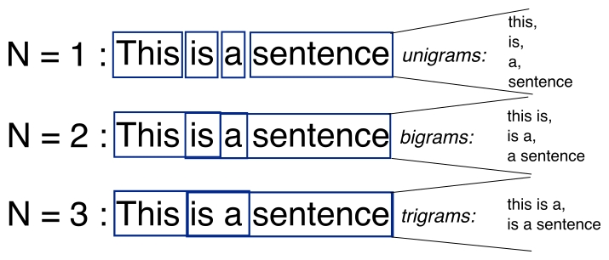
Implementing N-grams
import random
from collections import defaultdict
def build_ngram_model(text, n=2):
"""Build an n-gram language model from text."""
tokens = word_tokenize(text.lower())
ngrams_dict = defaultdict(list)
# Create dictionary of n-grams and possible next words
for i in range(len(tokens) - n):
current_ngram = tuple(tokens[i:i+n])
next_word = tokens[i+n]
ngrams_dict[current_ngram].append(next_word)
return ngrams_dict
def generate_text(model, seed, length=20):
"""Generate text using the n-gram model."""
current = seed
result = list(seed)
for _ in range(length):
if current in model:
# Randomly select a possible next word
next_word = random.choice(model[current])
result.append(next_word)
# Update current n-gram
current = current[1:] + (next_word,)
else:
# If current n-gram is not in model, break
break
return ' '.join(result)
# Sample text corpus
corpus = """Large language models are transforming how businesses operate.
These models can understand language, generate text, and perform various tasks.
Businesses use language models for customer service, content creation, and data analysis.
Language models learn patterns from vast amounts of text data."""
# Build a bigram model
bigram_model = build_ngram_model(corpus, 2)
# Generate text using the model
seed = ('language', 'models')
generated_text = generate_text(bigram_model, seed)
print(generated_text)
# Output might be: "language models learn patterns from vast amounts of text data businesses use language models for customer service content creation and data analysis"

Slide 34
Perplexity
Perplexity measures how confused a language model is when predicting text.
What It Means
Lower perplexity = Model is more confident and accurate
Higher perplexity = Model is more uncertain and confused
Simple Example
Imagine you're trying to predict the next word in: "I went to the _____"
A good model might assign high probability to words like "store," "park," "beach"
A confused model might spread probabilities evenly across thousands of words
Perplexity essentially counts how many reasonable options the model is considering. If the model has a perplexity of 10, it's like the model is equally confused between 10 possible words.
Real-World Comparison
If your phone keyboard suggests 3 very likely next words, it has low perplexity. If it suggests random unrelated words, it has high perplexity.
Why It Matters
Think of perplexity as a "confusion score" that helps researchers:
Compare different language models
Check if a model is improving during training
Identify when a model works better for certain types of text
The best language models today have much lower perplexity than older models, which is why they produce more natural-sounding text.

Slide 35
Limitations of N-gram Models
Limited context: Only consider a fixed number of previous words
No long-range dependencies: Cannot capture relationships between distant words
No semantic understanding: Model captures statistical patterns but not meaning
Memory intensive: Storing all possible n-grams requires significant space
Data sparsity: Many valid word combinations don't appear in training data

